Slide 1

Does population density affect the measure of a country’s happiness?
Team Name: Backrow
Team Members:
Alexandra SOlAno
Claudia Palmer
Donatienne Noel
John S cHAPEK

Slide 2

Contents of report
BACKGROUND
DATA SOURCES
METHODS/TOOLS
EXPECTATIONS
SUMMARY

Slide 3
BACKGROUND
1960 study on behavioral changes in mice with increasing/decreasing population amounts
Discovery from study:
The behavior of mice degraded with over population.
Purpose of our study: to see if modern data about population density in a country can be applied along with data that has already holistically measured the relative happiness of countries/places.

Slide 4
Expectations
Several of the variables in the 2019 Happiness Study should have a positive correlation with the determined happiness score.
As measures of freedom, trust, life-expectancy, GDP per capita and social-support increase, the happiness score should increase as well.
However, when merging the 2019 Population Density data, we expect that as population density increases, happiness score will decrease.

Slide 5
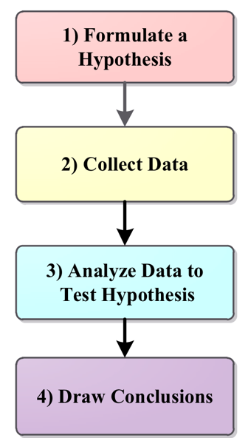
Methodology
The Methodology used to conduct our final analysis was as follow:
Formulate a Hypothesis
Collect and Clean the Data
Analyze the Data to Test the Hypothesis
Draw Conclusions

Slide 6
hypothesis
Objective: to further analyze how population density plays a role in the world happiness.
Method: collect data on the population density of countries for 2019 and merge that information with the happiness scores calculated for each country by the World Happiness Report 2019.
Hypothesis Testing
Hypothesis : The degree of human happiness, as measured by a happiness score, in a country increases if the country has a low population density.
Null Hypothesis : The degree of human happiness changes with population density due to random chance.

Slide 7
Data Sources & Analysis
Data sources include:
CSV files from Kaggle “World Happiness Report 2019”
CSV file of “World Population Density Data 2019”
“World Population Density Data 2019”
Population density per country
“World Happiness Report 2019”
Has measures of each country’s
freedom
Trust
social-support
life-expectancy
GDP per capita
All combined to create a happiness score

Slide 8
Initial Data Analysis
We decided to conduct an exploratory Data Analysis by utilizing the Scatter Plot to depict a series of points that show how two variables are related to each other. For the following:
Density vs Ladder
Population vs Ladder
Freedom vs Ladder
Social Support vs Ladder
Health Expectancy vs Ladder
Corruption vs Ladder
Log of GDP vs Ladder
Generosity vs Ladder

Slide 9
Challenges
Some of the challenges we encountered:
Unable to run a T-Test , but the sample size did not meet the requirements – variables were Ordinal
Team attempted to conduct a Chi 2, but our dataset was not categorized – Sample did not meet the requirements
In the end we could not draw a hypothesis to prove that a specific group of variables contributed to the World Happiness score

Slide 10
Solution to the challenge
Use of Regression Analysis framework to estimate the strength of the relationship between the variables
Use of the following libraries - Scipy to calculate the R square and Sklearn to get the linear regression
To find a strong correlation between the variables, we conducted a linear regression for each variables and we paired them with an independent variable - the ladder
Each paired variables we described them with the following equation:
Y= mX + b
Y representing the independent variables
X representing the dependent variables
b the intercept
This solution gave us more emerging scatter plots in which the relationship appears to be linear

Slide 11
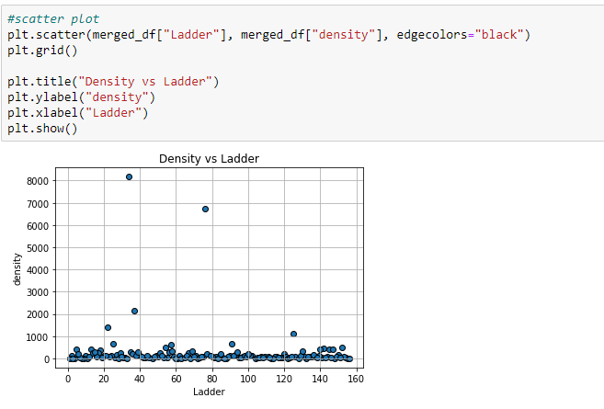
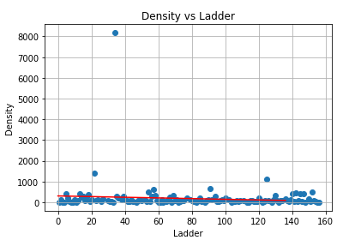
OUR FINDINGS – Density vs Ladder
R = .0081 far to One, - Not a strong relationship between the variables - Density and Happiness.

Slide 12
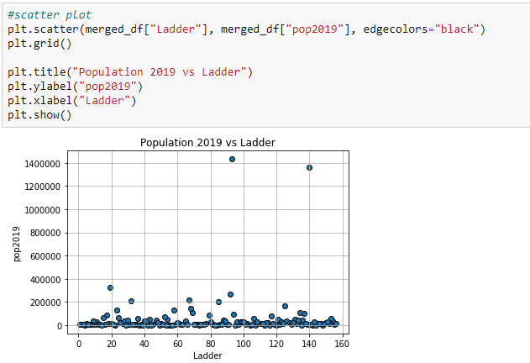
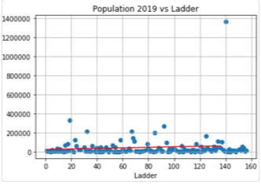
OUR FINDINGS – Population 2019 vs ladder
R =.0079 Far to One - Not a strong relationship between the variables - population and Happiness

Slide 13
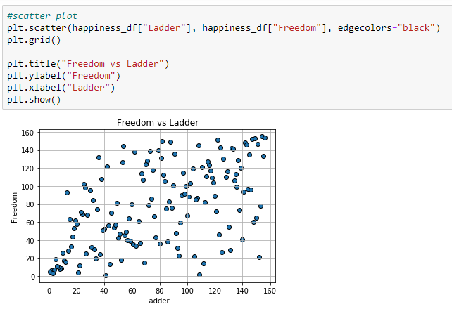
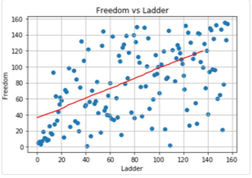
OUR FINDINGS – Freedom vs ladder
R =.29 far to One - Not a strong relationship between the variables - freedom and Ladder

Slide 14
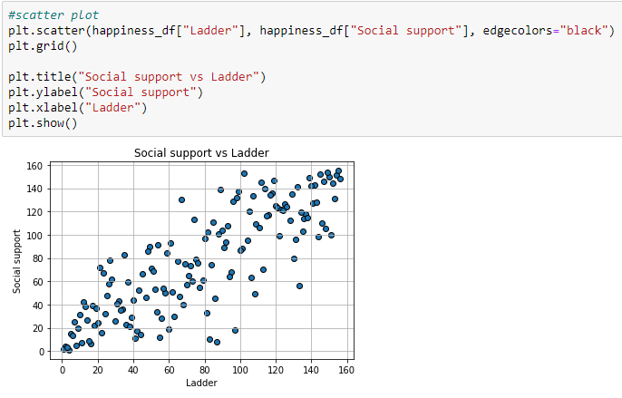
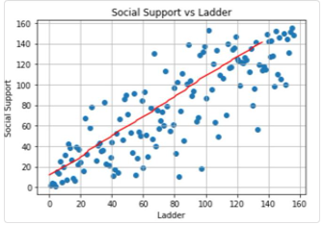
OUR FINDINGS – Social support Vs Ladder
R = .69 Closer to One - A strong relationship exist between the variables - freedom and Ladder

Slide 15
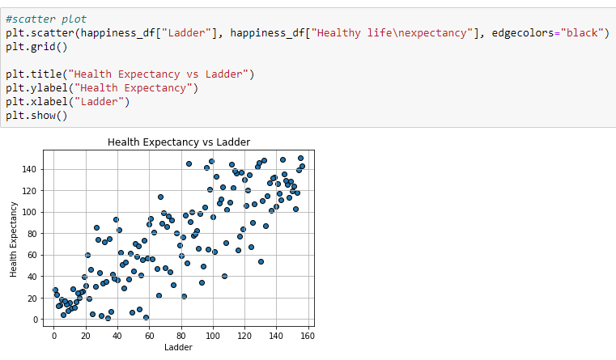
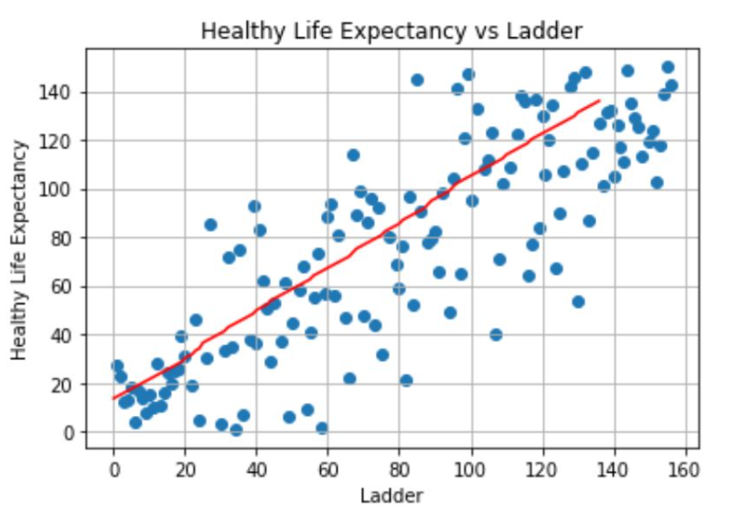
OUR FINDINGS – Health Expectancy vs ladder
R = .68 – Closer to One – A strong relationship between the variables - Health Expectancy and Ladder

Slide 16
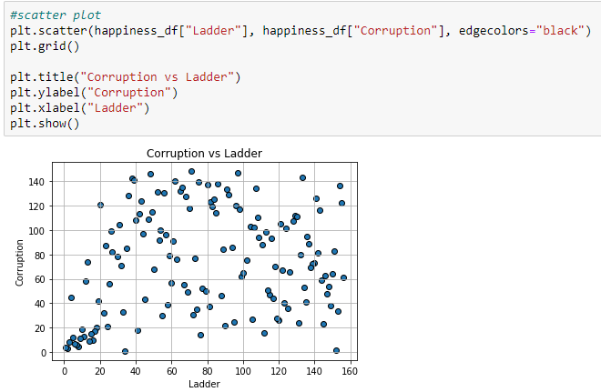
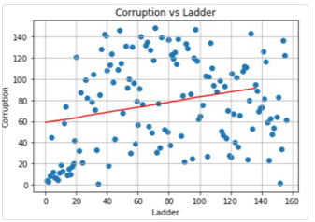
OUR FINDINGS – Corruption vs ladder
R = .005 – far to One – Not a strong relationship between the variables - Corruption and Ladder

Slide 17
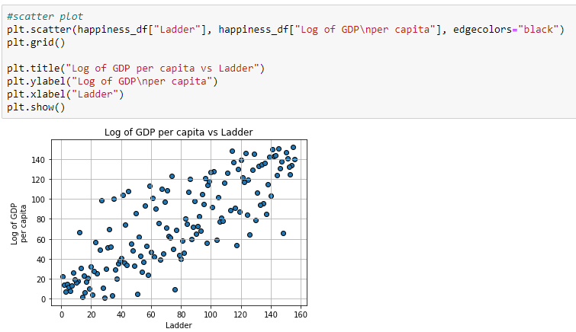
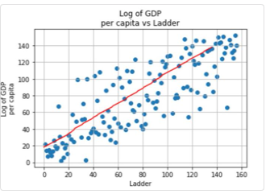
OUR FINDINGS: GDP PER CAPITA vs ladder
R = .67 Closer to One - A strong relationship exists between the variables - GDP per Capita and Ladder

Slide 18
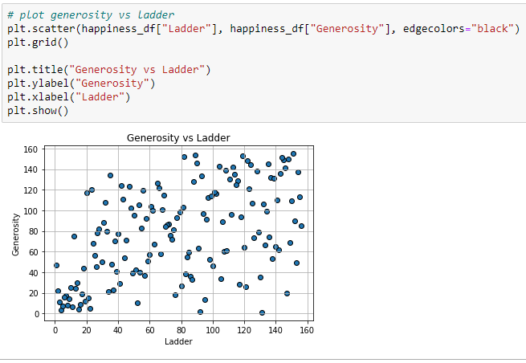
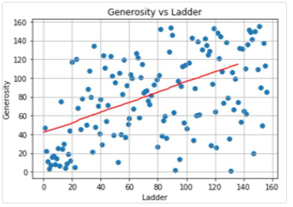
OUR FINDINGS Generosity vs ladder
R = .23 far to One - Not a strong relationship exist between the variables - Generosity and Ladder

Slide 19
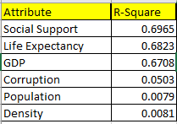
Summary
The table summarizes the variables and their corresponding R- square values from the linear regressions. The list of attributes shown held the three highest values (Social Support, Life Expectancy, and GDP), and the lowest three were (Corruption, Density, and Population). This makes sense as positive values for a cultures health and economics should correlate strongly with that cultures sense of individua well being.
Additionally, humans are more difficult to predict, especially conforming to a rigid linear model. More subjective measures aren’t often expected to correlate strongly to a linear model.
The highest correlation value was the more subjective value Social Support . The question that went into establishing that measure , essentially was “Do you have someone you could count on when in difficult times”
On the other hand, Corruption, the binary question feels more complicated and more liable to human biases “Is corruption widespread throughout the government or not?”. The lack of correlation in the R-square feels appropriate .
Lastly, there is no correlation between the Happiness Ladder and the Population Density. We are curious if this is because the data were blurred/averaged over the entire countries. If the data was on a finer scale, over cities within a state, the question we ask is “Would there be more apparent trends? There may even be more trends when looking at the degree of urbanization within a city or state.

